Slide 1

CC-215 Database Systems
— Unit 5 — Relational Algebra
Some slides and/or pictures are adapted from Lecture slides / Books of
Peter Rob
Jeffery. A. Hoffer
Thomas M. Connolly
Ramez Elmasri
Silberschtaz
Dr. Asif Sohail University of the Punjab Department of Information Technology, FCIT

Slide 2
Introduction
Relational algebra defines the theoretical way of manipulating table contents using the following relational operators:
SELECT or RESTRICT
PROJECT
PRODUCT
JOIN
INTERSECT
UNION
DIFFERENCE
DIVIDE

Slide 3
SELECT
Yields values for all rows found in a table.
Select can be used to either list all or list partial rows values that match a specified criterion (horizontal partitioning).
The select operation is expressed as:
σ_{condition} (relation)
Condition is formed using relational operators and logical operators (AND ^, OR ^{v}, NOT ~)
σ_{SAL>2000} (EMP), σ_{job = ‘CLERK’ ^ deptno =10} (EMP)
The fraction of tuples selected by selection condition is referred to as selectivity of the condition.

Slide 4
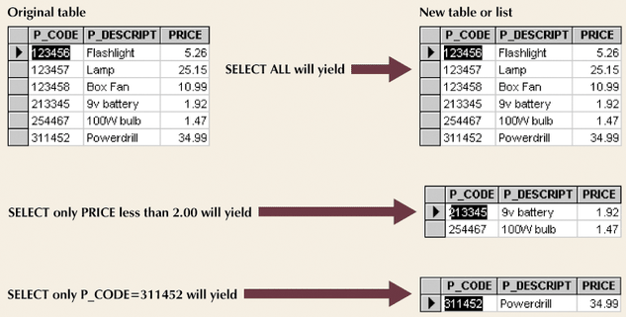
SELECT

Slide 5
PROJECT
Project yields a vertical subset of a table with selected attributes
The project operation is expressed as:
_{Attributes} (relation)
∏ _{ename, job, sal} (EMP)
Duplicate elimination: The result of the PROJECT operation is a set of distinct tuples.
Generalized Projection: It extends the projection operation by allowing functions of attributes.

Slide 6
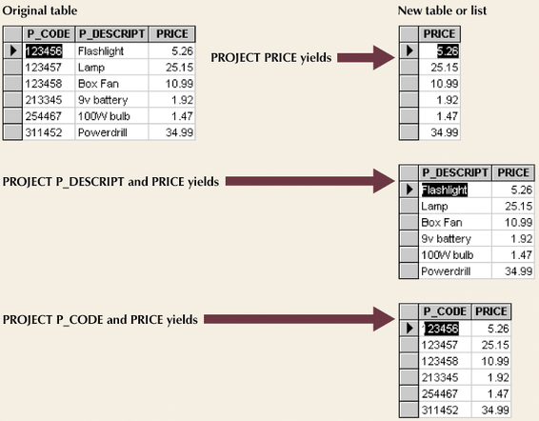
PROJECT

Slide 7
SELECT+PROJECT
Suppose we want to perform the following operations together:
It can be done in the following ways:
OR
σ_{PRICE < 2} (PRODUCT)
∏_{P_DESCRIPT, PRICE} (PRODUCT)
∏_{P_DESCRIPT, PRICE} (σ_{PRICE < 2} (PRODUCT))
PROD-TEMP ← σ_{PRICE < 2} (PRODUCT)
∏_{P_DESCRIPT, PRICE} (PROD-TEMP)

Slide 8
RENAME
Rename operation is used to rename a relation, or attributes of a relation, or both.
ρS(B₁, B₂, ... , B_{n})(R) or
ρS(R) or
ρ(B₁, B₂, ... , B_{n})(R)
The symbol ρ(rho) is RENAME operator, S and B_{i} are new names of relation/attributes.
The first expression renames both the relation and its attributes, the second renames the relation only, and the third renames the attributes only.

Slide 9
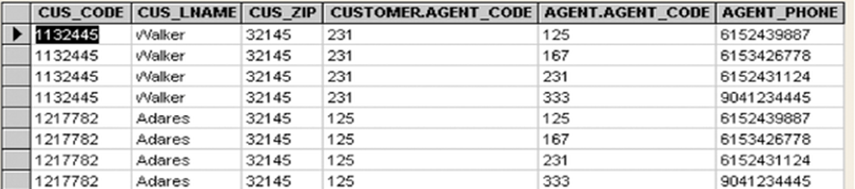
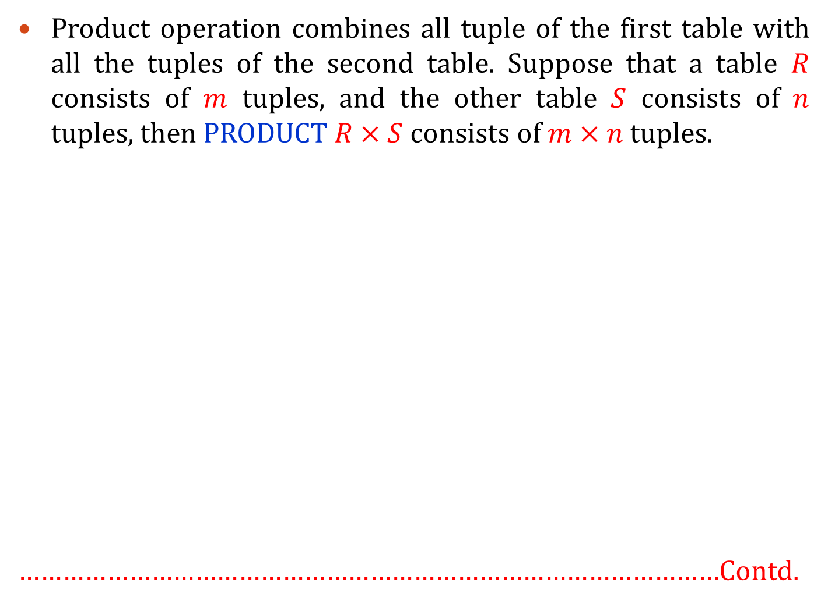
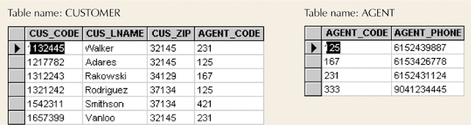
(Cartesian) Product or Cross Join
Product operation combines all tuple of the first table with all the tuples of the second table. Suppose that a table $R$ consists of $m$ tuples, and the other table $S$ consists of $n$ tuples, then PRODUCT $R×S$ consists of $m×n$ tuples.
……………………………………………………………………………………Contd.

Slide 10
JOIN Operation
The JOIN operation, is used to combine related tuples from two relations (usually a referencing relation and a referenced relation) such that each tuple pair satisfy some condition.
A JOIN operation includes PRODUCT, SELECT, and PROJECT.
The general form of JOIN operation on two relations R(A₁, A₂, … , A_{n}) and S(B₁, B₂, … , B_{m}) is
There are following join types:
Theta Join
Inner Join
Equi Join
Natural Join
Outer Join (Left | Right | Full)
Semi Join (Left | Right)

Slide 11
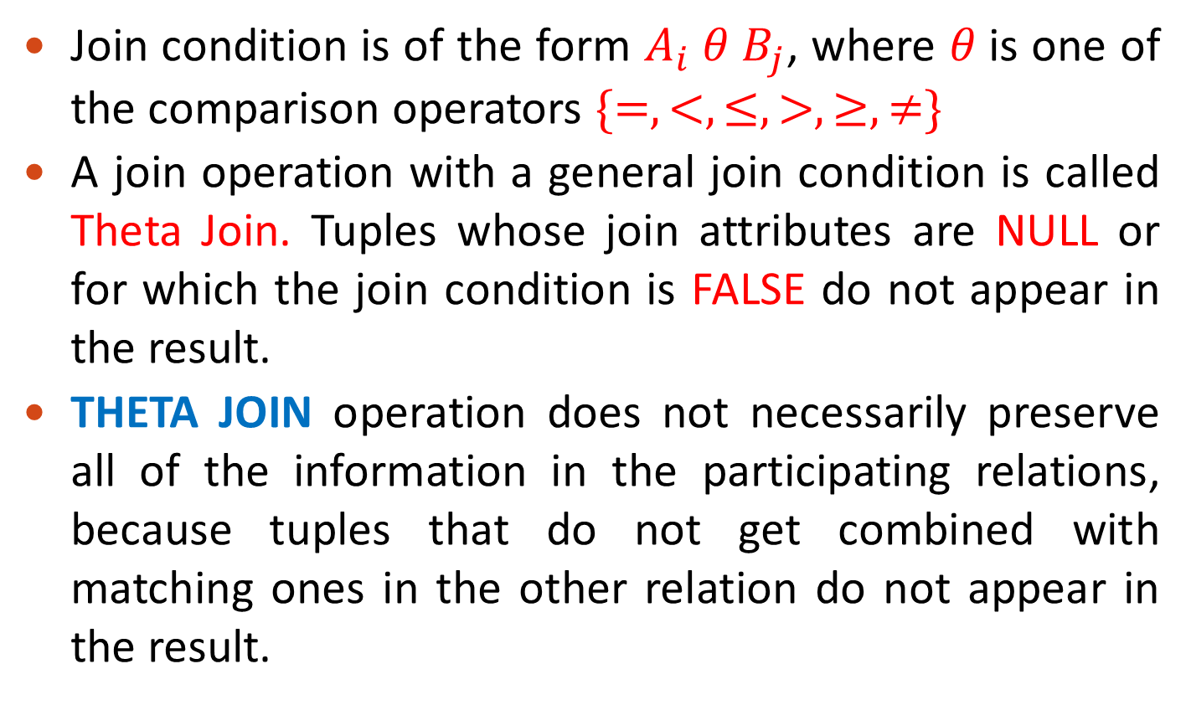
Theta Join

Slide 12
INNER JOIN
σ_{R.A = S.A} (R x S)
R S
EQUIJOIN: A JOIN type, with = comparison operator.
NATURAL JOIN displays the join attribute only once. The join attribute should have same name in two relations.
Relation R
A | B | C_{R}
A1 | B1 | C1
A2 | B2 | C2
A3 | B1
Relation S
C_{S} | D
C1 | D1
C2 | D2
C3 | D3
R EQUIJOIN S
A | B | C_{R} | C_{S} | D
A1 | B1 | C1 | C1 | D1
A2 | B2 | C2 | C2 | D2
Relation R
A | B | C
A1 | B1 | C1
A2 | B2 | C2
A3 | B1
Relation S
C | D
C1 | D1
C2 | D2
C3 | D3
R NATURAL JOIN S
A | B | C | D
A1 | B1 | C1 | D1
A2 | B2 | C2 | D2

Slide 13

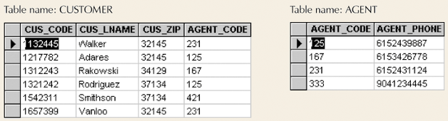
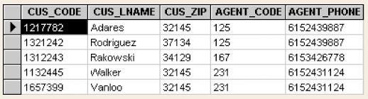
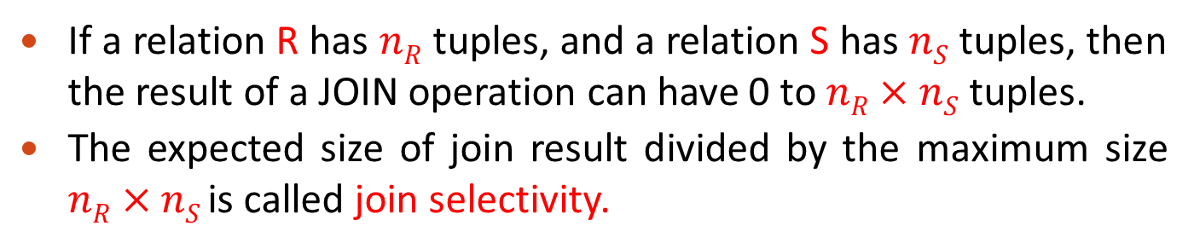

Slide 14
OUTER JOIN
Inner join yields the matching tuples only.
Outer join can keep all the tuples in R, or all those in S, or all those in both relations in the result of the JOIN, regardless of whether or not they have matching tuples in the other relation.
There are the following three type of outer join:
LEFT Outer Join: Specifies that the results be generated using all rows from R (first relation). For those rows in R that don't have corresponding rows in S, NULLs are returned in the result
RIGHT Outer Join: Specifies that the results be generated using all rows from S (second relation). For those rows in S that don't have corresponding rows in R, NULLs are returned in the result.
FULL Outer Join: Specifies that the results be generated using all rows from R and S. For those rows in R that don't have corresponding rows in S, NULLs are returned in the result, and vice-versa.

Slide 15
OUTER JOIN
Relation R
A | B | C_{R}
A1 | B1 | C1
A2 | B2 | C2
A3 | B1
Relation S
C_{S} | D
C1 | D1
C2 | D2
C3 | D3
R LEFT OUTER JOIN S
A | B | C_{S} | D
A1 | B1 | C1 | D1
A2 | B2 | C2 | D2
A3 | B1
Relation R
A | B | C_{R}
A1 | B1 | C1
A2 | B2 | C2
A3 | B1
Relation S
C_{S} | D
C1 | D1
C2 | D2
C3 | D3
R RIGHT OUTER JOIN S
A | B | C_{S} | D
A1 | B1 | C1 | D1
A2 | B2 | C2 | D2
 |  | C3 | D3
Relation R
A | B | C_{R}
A1 | B1 | C1
A2 | B2 | C2
A3 | B1
Relation S
C_{S} | D
C1 | D1
C2 | D2
C3 | D3
R FULL OUTER JOIN S
A | B | C_{S} | D
A1 | B1 | C1 | D1
A2 | B2 | C2 | D2
A3 | B1
 |  | C3 | D3

Slide 16
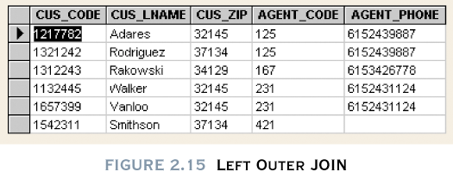
Left Outer JOIN

Slide 17
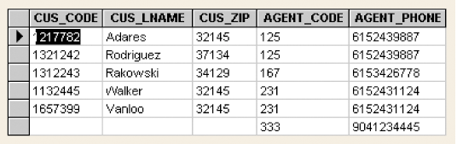
Right Outer JOIN

Slide 18
Left Semi Join
Left Semi Join of two relations R and S, written as R |x S is found by taking the natural join of R and S and then projecting the result onto the attributes of R.
The result will be just those tuples of R that participate in the natural join.
Relation R
A | B | C_{R}
A1 | B1 | C1
A2 | B2 | C2
A3 | B1
Relation S
C_{S} | D
C1 | D1
C2 | D2
C3 | D3
R |x S
A | B | C_{R}
A1 | B1 | C1
A2 | B2 | C2

Slide 19
Right Semi Join
Right Semi Join of two relations R and S, written as R x| S is found by taking the natural join of R and S and then projecting the result onto the attributes of S.
The result will be just those tuples of S that participate in the natural join.
Relation R
A | B | C_{R}
A1 | B1 | C1
A2 | B2 | C2
A3 | B1
Relation S
C_{S} | D
C1 | D1
C2 | D2
C3 | D3
R x| S
C_{S} | D
C1 | D1
C2 | D2

Slide 20
Joins Math
R_{T} = Number of tuples in relation R (first or left table)
S_{T} = Number of tuples in relation S (second or right table)
M = Number of matching tuples in R and S
R_{N} = Number of non-matching tuples in R
S_{N} = Number of non-matching tuples in S
Join Type | Number of Tuples
Cartesian | R_{T} x R_{S}
Inner or Equi | M
Left Outer | M + R_{N}
Right Outer | M + S_{N}
Full Outer | M + R_{N} + S_{N}

Slide 21
Summary

Slide 22
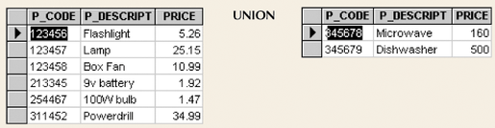
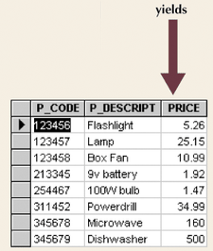
Union
Type compatibility: Tables must have the same attribute characters (column and domains must be identical)
The result of union operation, denoted by R ∪ S, is a relation that includes all tuples that are either in R or in S or in both R and S. Duplicate tuples are eliminated.

Slide 23
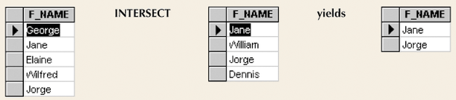
Intersect
The result of intersect operation, denoted by R ∩ S, is a relation that includes all tuples that are in both R and S.

Slide 24
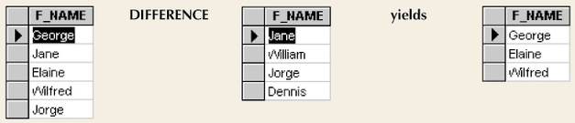
Difference (Minus or Except)
The result of Minus operation, denoted by R – S, is a relation that includes all tuples that are in R but not in S.

Slide 25
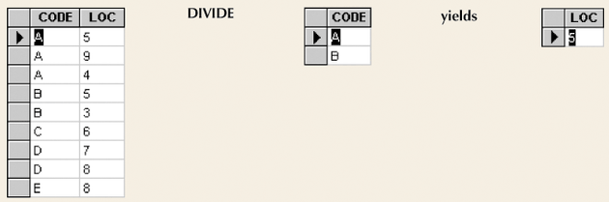
Divide
Requires one single-column table and one two-column table.
A tuple t appears in the result T of the DIVISION, iff the values in t appear in R in combination with every tuple in S.
The tuples in the denominator relation S restrict the numerator relation R by selecting those tuples in the result that match all values present in the denominator.

Slide 26
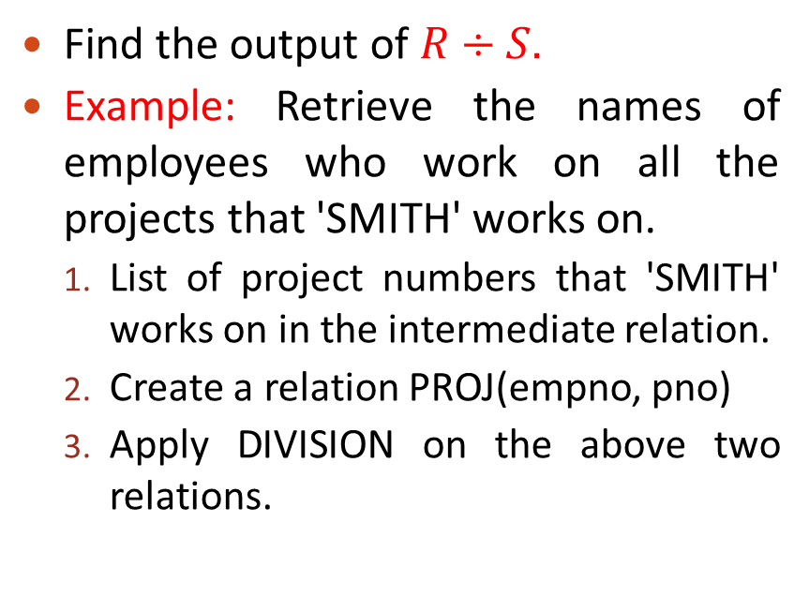
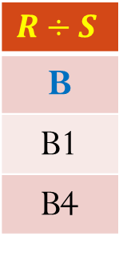
DIVISION
Relation R
A | B
A1 | B1
A2 | B1
A3 | B1
A4 | B1
A1 | B2
A3 | B2
A2 | B3
A3 | B3
A4 | B3
A1 | B4
A2 | B4
A3 | B4
S
A
A1
A2
A3
PROJ
Empno | Pno
E1 | 1
E1 | 2
E2 | 1
E3 | 2
Smith_Pno
1
2
B
B1
B4

Slide 27
Reading Material
Database Systems – Design, Implementation and Management: Carlos Coronel, Steven Morris (13th Ed.)
Modern Database Management: Jeffery. A. Hoffer (12th Ed.)
Database Systems: Thomas M. Connolly (6th Ed.)
Fundamentals of Database Systems: Elmasri (7th Ed.)
Database System Concepts: Abraham Silberschatz (7th Ed.)
Databases Illuminated: Catherine M. Ricardo (3rd Ed.)
Book | Section(s) / Chapter
A | 3.4
B | NIL
C | 5.1
D | 8.1 to 8.5
E | 2.5, 2.6,
F | 4.5

